Slide 1
Space for Cycling
To create the conditions where anyone can cycle anywhere

Slide 2
What?
Space for Cycling is a campaign for high quality networks of cycle infrastructure
Space for Cycling calls on councils to:
Plan – plan full networks of cycle routes
Invest – actively seek the funding to build the network
Build – build the network using up to date high quality design standards

Slide 3
Why cycling?

Slide 4
Health
Cycling prevents many physical and mental health diseases
Boys aged 10-16 30% more likely to meet recommended fitness levels
Girls who cycle are 7 times more likely.
Adults who cycle regularly typically enjoy a level of fitness equivalent to someone 10 years younger and their life expectancy is two years above the average.
Cycling fits into daily routines easier than other forms of exercise.
One less exhaust pipe!

Slide 5
Air quality
Air pollution kills roughly 40,000 people in UK annually
Motor vehicles are major source of air pollution
Pollution from motor vehicles accounts for the same number of child asthma cases as passive smoking
The UK is in repeated breach of legal air pollution limits

Slide 6
Economy
Investing in cycling is low cost compared to other transport
Cycling is low cost to individuals, freeing up more disposable income to spend elsewhere
Average economic benefit to cost ratio of investing in cycling is 13:1
Cycling relieves pressure on health services
People who cycle take fewer sick days
People cycling stop more frequently at local businesses

Slide 7
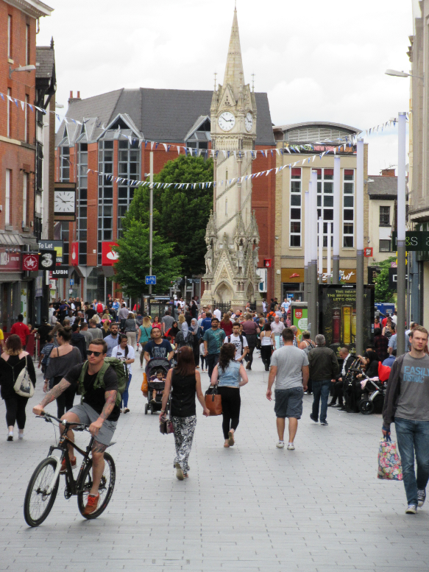
Space for people
Safer streets for children to play in
Safe streets for children to travel around
More pleasant environments to be in and shop in
Fewer toxic fumes
Less congestion

Slide 8
What is Space for Cycling?

Slide 9
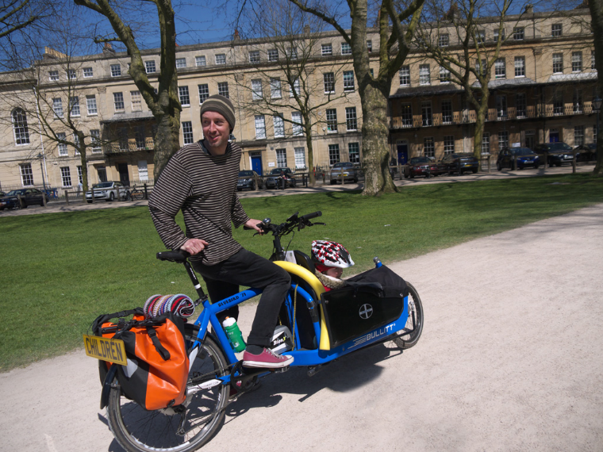
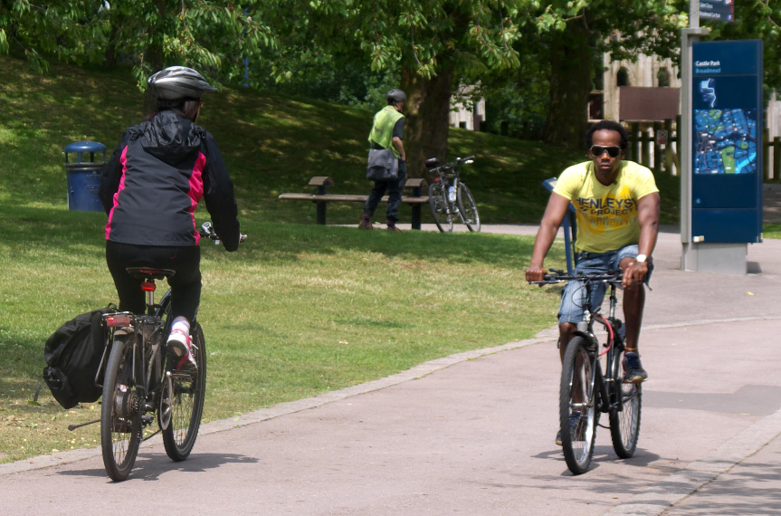
Green spaces

Slide 10
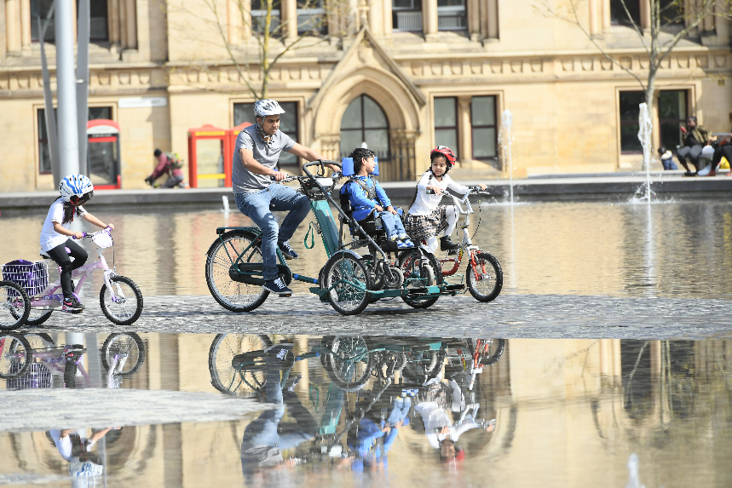
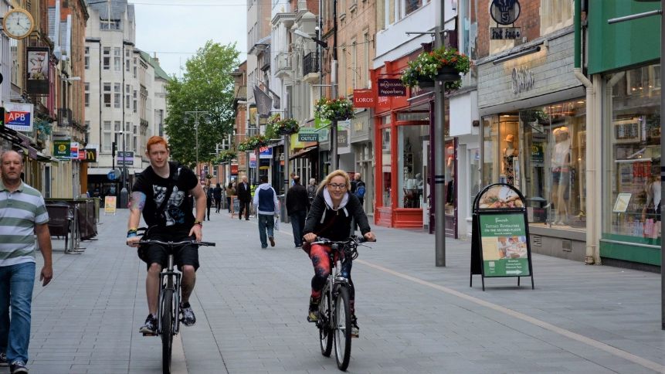
Motor free spaces

Slide 11
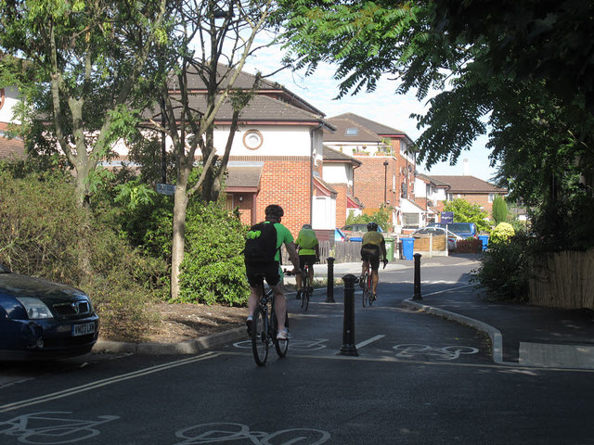
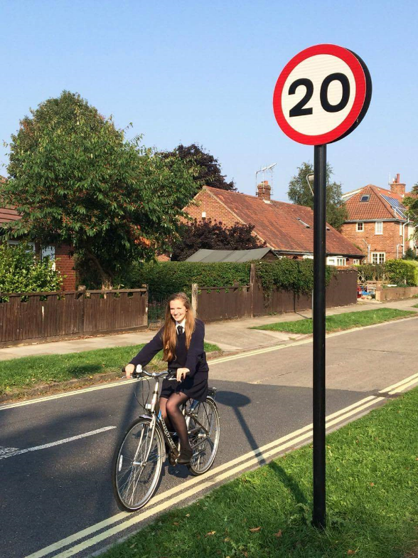
Reduced traffic volumes and speeds

Slide 12
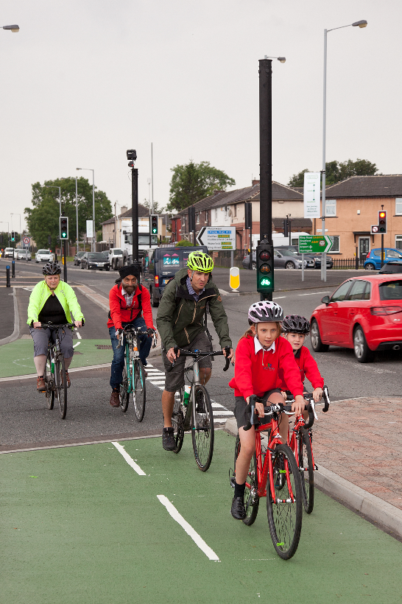
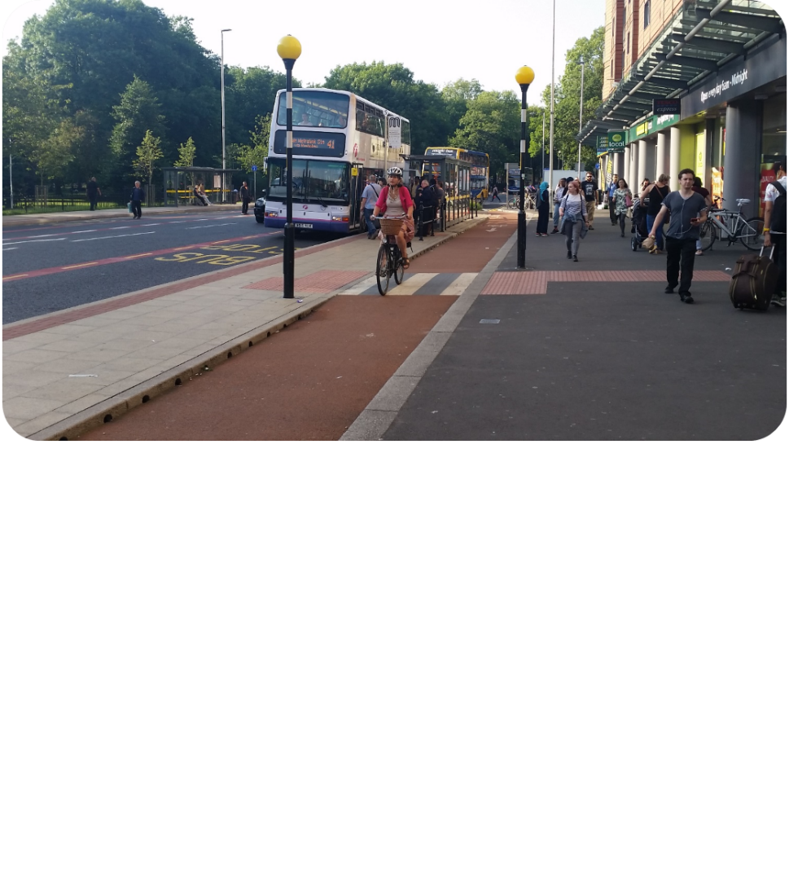
Protected space

Slide 13
Network

Slide 14
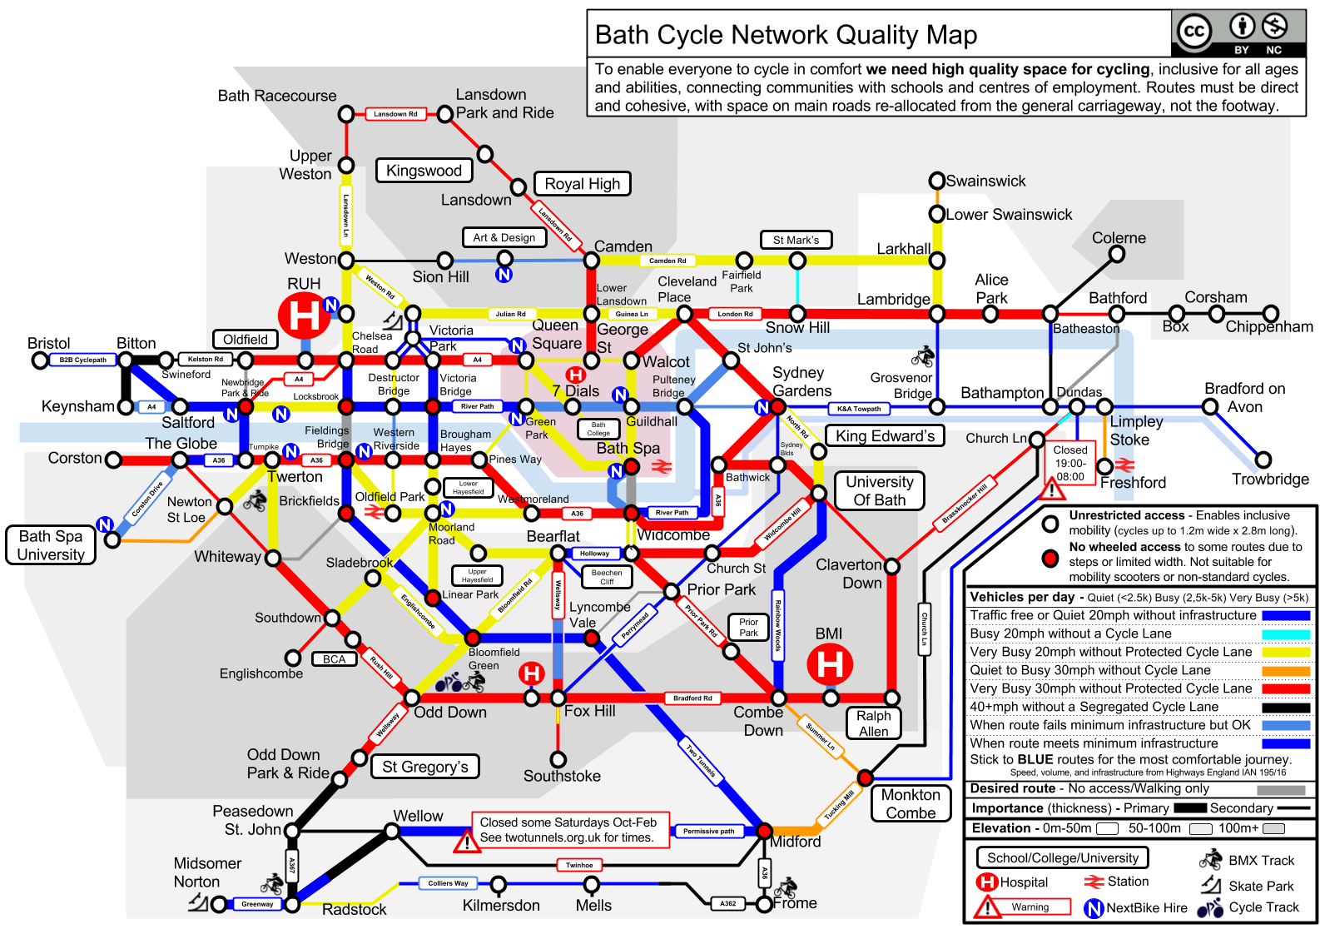

Slide 15
The Space for Cycling process

Slide 16
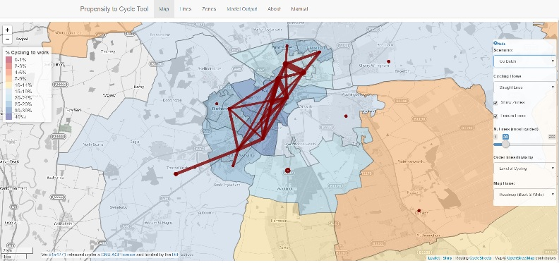
Plan
Produce a costed plan
Local Cycling and Walking Infrastructure Plans (LCWIPs)
“Connect places that people need to get to”

Slide 17
Invest
How much will your network cost to deliver per head annually?
Access Fund
Local Growth Deals (LEPs)
Local Sustainable Travel Fund
Revenue funding streams
Local transport budget

Slide 18
Build
London Cycling Design Standards
Active Travel (Wales) Act guidance
Consult – national bodies and local residents

Slide 19
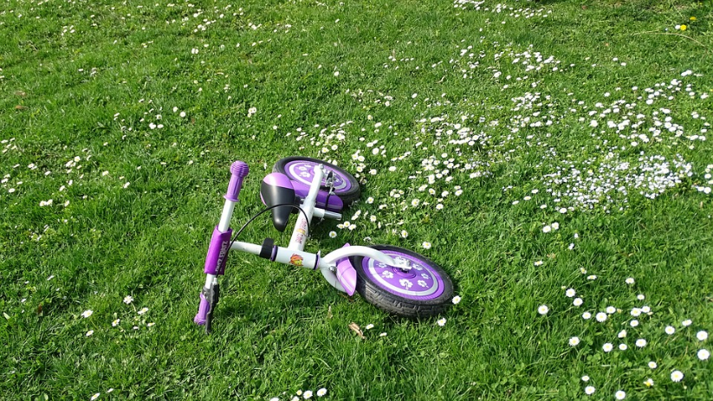
Next steps
Pass a motion to support Space for Cycling
Produce a costed plan (LCWIP)
Create a cycle forum and have regular meetings
Let us know how we can help!

Slide 20
Any questions?

