Slide 1
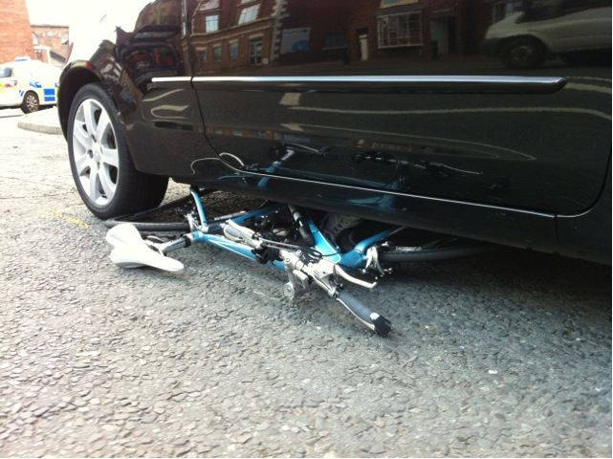

Public health costs of road safety
Christopher Peck – CTC, the national cycling charity (UK)
Velo-City 2013 Vienna

Slide 2
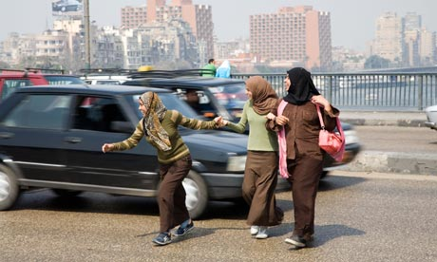

What is road safety?
“By 2020 there will be 1.9m killed each year on the roads, 50m injured.” – UN Decade of Road Safety

Slide 3
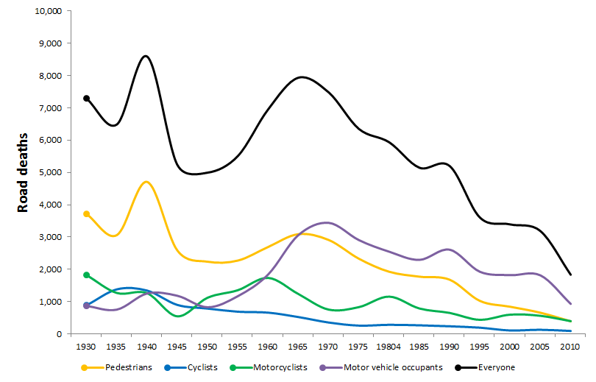
Road deaths in GB 1930-2010
Cycle fatalities have fallen by 92% since the 1940s

Slide 4


Rate per 100,000 people

Slide 5
Per billion kms

Slide 6
How to get it wrong, spectacularly
“As you massively increase the amount of people who cycle, your figures for deaths go up. On the European table I have here, the Netherlands is fourth from the bottom, with 0.84 per 100,000 of population, whereas we [UK] are seventh with 0.17.
…
I think the Netherlands might want to come and see us to find out how we are making sure that so few people are killed in cycling terms as we increase the numbers of people cycling, because the figures would indicate that we can perhaps do a bit better than them.”
- Road Safety Minister Mike Penning, speaking in the UK Parliament in 2012

Slide 7
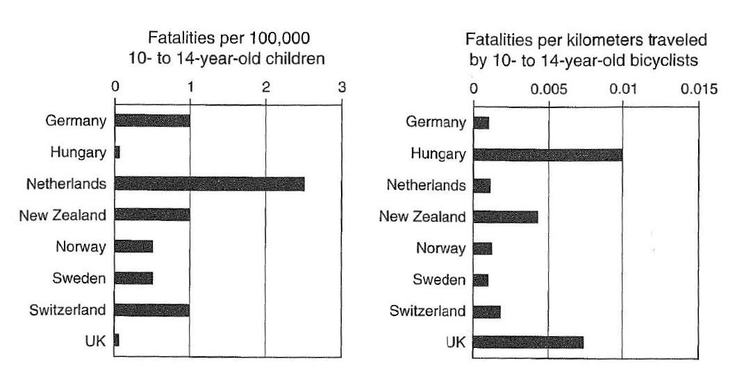
Measuring risk of cycling, wrong and right

Slide 8
Which road user is involved in the most road deaths?
883
453
362
107
7
34
27
28

Slide 9
Which road user represents the most danger per mile travelled?

Slide 10
Overweight and obese, 1980-2011
In the USA, obesity increased from

Slide 11
Public health consequences of…
Physical inactivity reduces mortality risks of these cancers by 30-50%
Around 35% of cardiovascular diseases attributable to physical inactivity + another ~25% partly attributable to air pollution

Slide 12
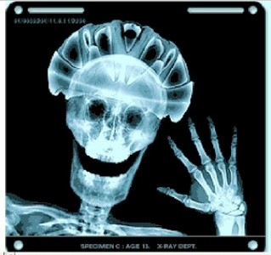
Where ‘road safety’ goes wrong
Any intervention or law that reduces physical activity will almost inevitably do more harm than good.
de Jong (2012) – helmet legislation or promotion only has a net health benefit if injuries prevented exceed health costs lost to reduced cycling.
This is: “very difficult to achieve except in extreme circumstances”

Slide 13
Conclusions
Set targets and measure the right things…
Numbers of people killed or seriously injured | Very bad
Rate of death or injury to users per 100,000 population (current) | Poor
Rate of death or injury per mile, trip or hour (measured by some) | Better
Rate of death or injury to third parties (danger posed) | Good
Overall public health impact of different transport modes (road death or injury caused AND air quality, cardiovascular disease etc) | Best
Get the balance right between promoting cycling for public health and road safety campaigns or laws which deter people from cycling

Slide 14
Questions?
How is safety and risk measured where you live?
How do we change institutional and organisational approaches to risk and safety?
Thanks!
Christopher Peck
CTC – the national cycling charity
chris.peck@ctc.org.uk

