Slide 1

Space for Cycling
To create the condition where anyone can cycle anywhere
Tom Guha
Space for Cycling Campaigner
tom.guha@cyclinguk.org
#space4cycling

Slide 2
What are we calling for?
We want councils to:
Plan – Plan a full network of cycle-friendly routes
Invest – Actively seek the funding to implement the network
Build – Build the network using the most up-to-date high quality design standards

Slide 3
Why?
Sets out a process to help your council with
Corresponding toolkit
Gov thinking in terms of networks: Cycling and Walking Investment Strategy (CWIS)
Lessons from Netherlands are that a full network is needed to get everyone cycling

Slide 4
What are we doing today?
Stage 1 – Create a coherent message
Stage 2 – Activate activists
Stage 3 – Public support
Stage 4 – Political support

Slide 5
Aim of the day
Help your council create Space for Cycling!
Share expertise
Upskill
Network
Get enthused!

Slide 6
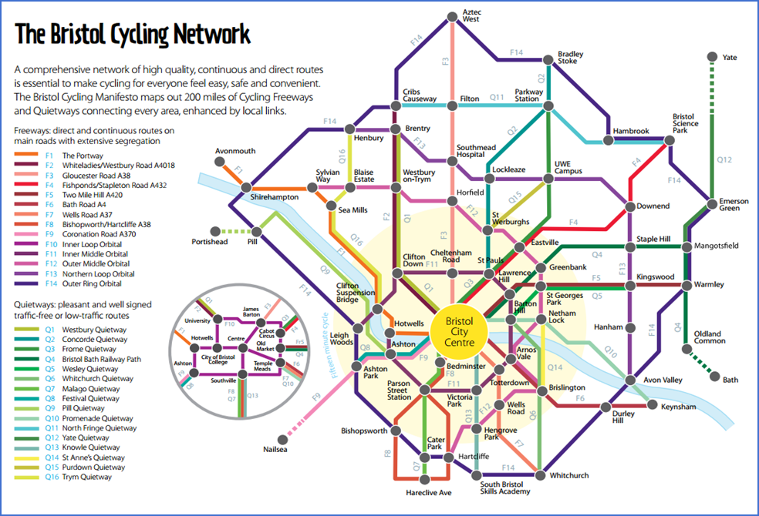
Step 1: Plan
              Creating a ‘Tube Map’

Slide 7
Step 2: Invest
https://www.cyclescape.org/

Slide 8
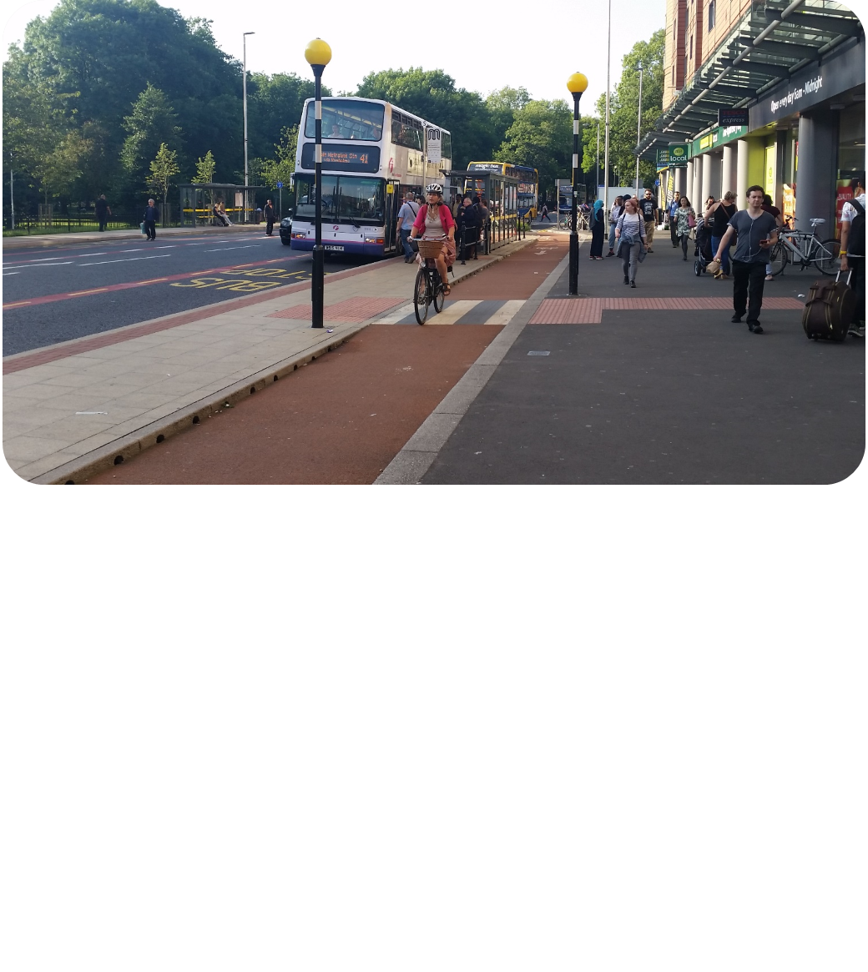
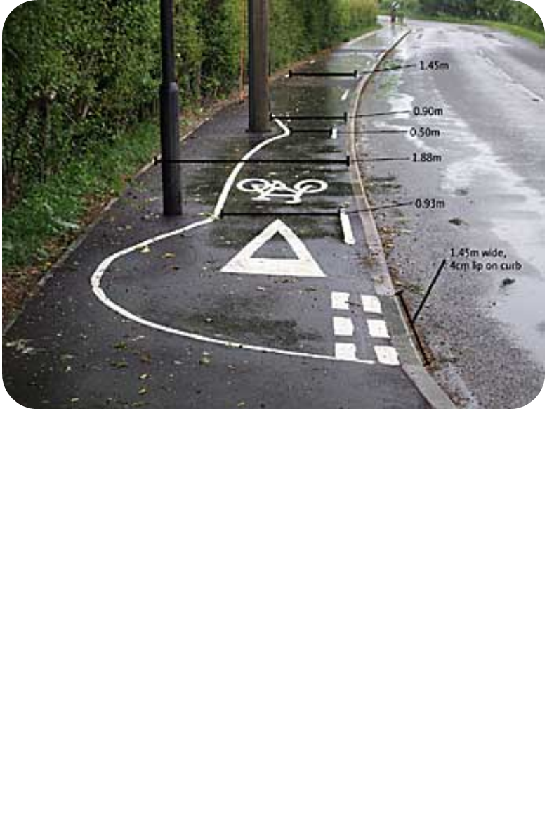
Step 3: Build
Audit using Cycle Environment Assessment Tool

Slide 9
Forming and running a campaign group
Recruiting members – finding people who support your cause
Using your skill base – delegating jobs effectively
Prioritising issues – where to start and where to focus
What web tools exist to support you

Slide 10
Working with your local authority
CWIS
LCWIPs
How to get your voice heard

Slide 11
Consultations and the planning system
How to respond to consultations and influence local plans

Slide 12
What next?

Slide 13
What next?
Continue the conversation – Space for Cycling Google Group
Join / Form a campaign group
Create a ‘Tube Map’ network
Create street visualisations
Start using online tools – Cyclescape / PCT / CEAT

Slide 14
Elections
Crowdsource candidate data – Democracy Club Google Group
Lobby candidates
Go big on asks – Space for Cycling ‘Plan, Invest, Build’ and localised asks
Space for Cycling rides – April 22nd

Slide 15
No/post elections
Get Councillors signed up to Space for Cycling
Get council signed up to Space for Cycling – Council motion
Hold Councillors to account on promises

Slide 16
If you need any help…
Tom Guha
Space for Cycling Campaigner tom.guha@cyclinguk.org
01483 238 321
Cyclinguk.org/spaceforcycling
#space4cycling

