Slide 1
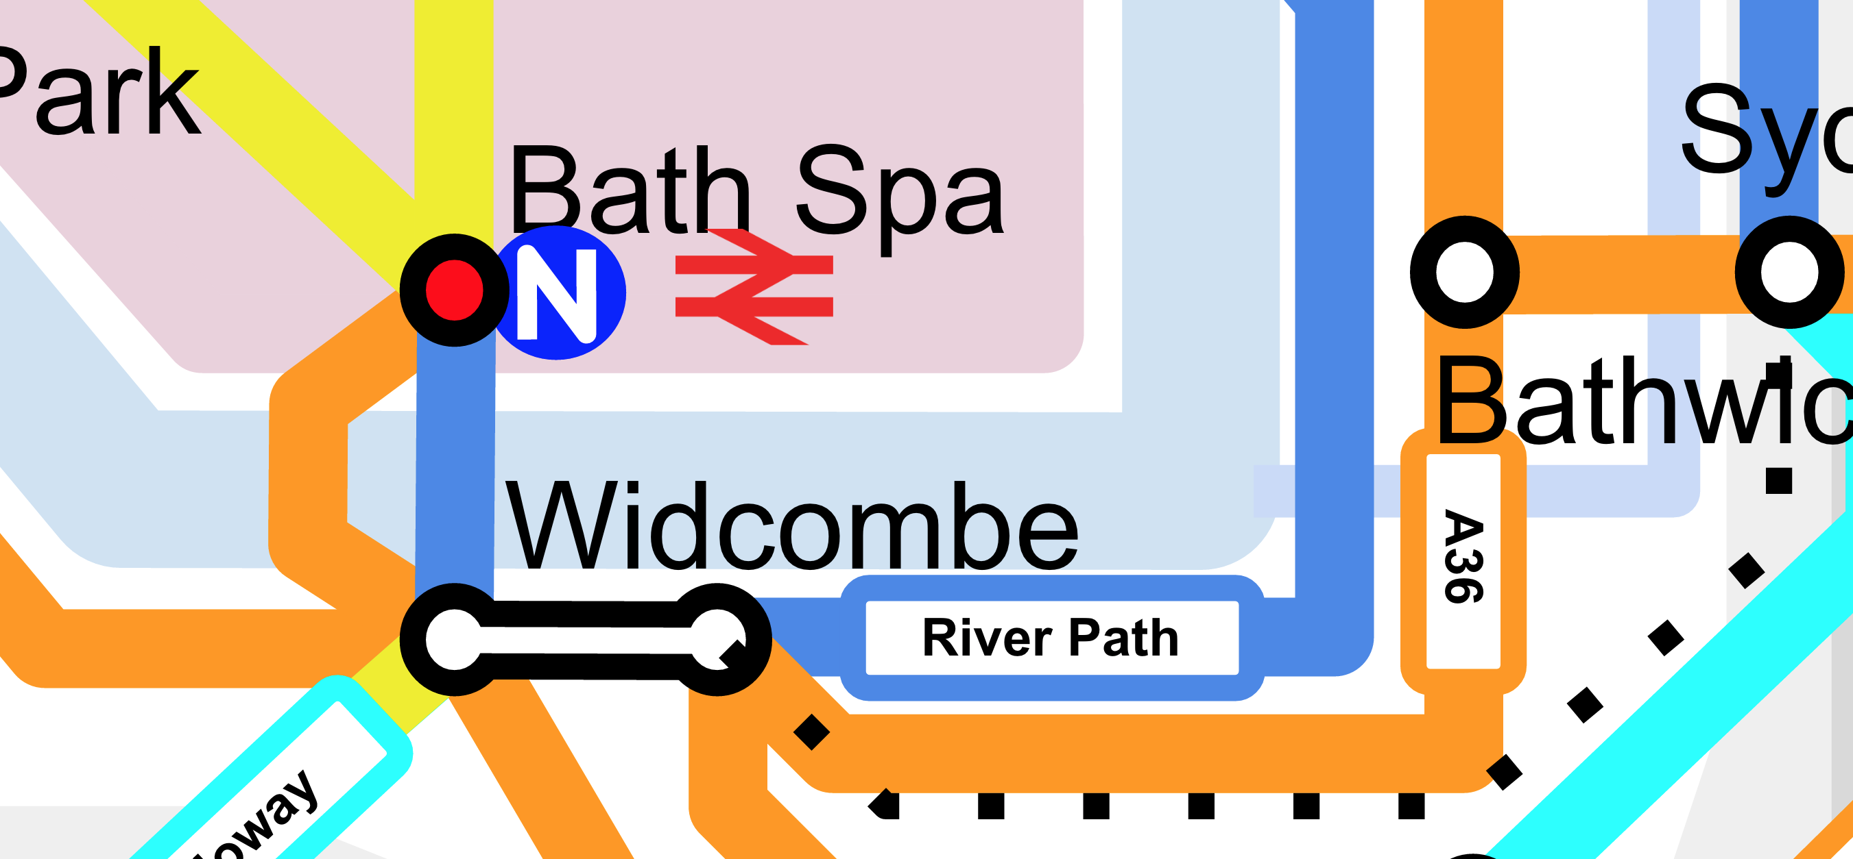
Developing A Network Quality Map

Slide 2
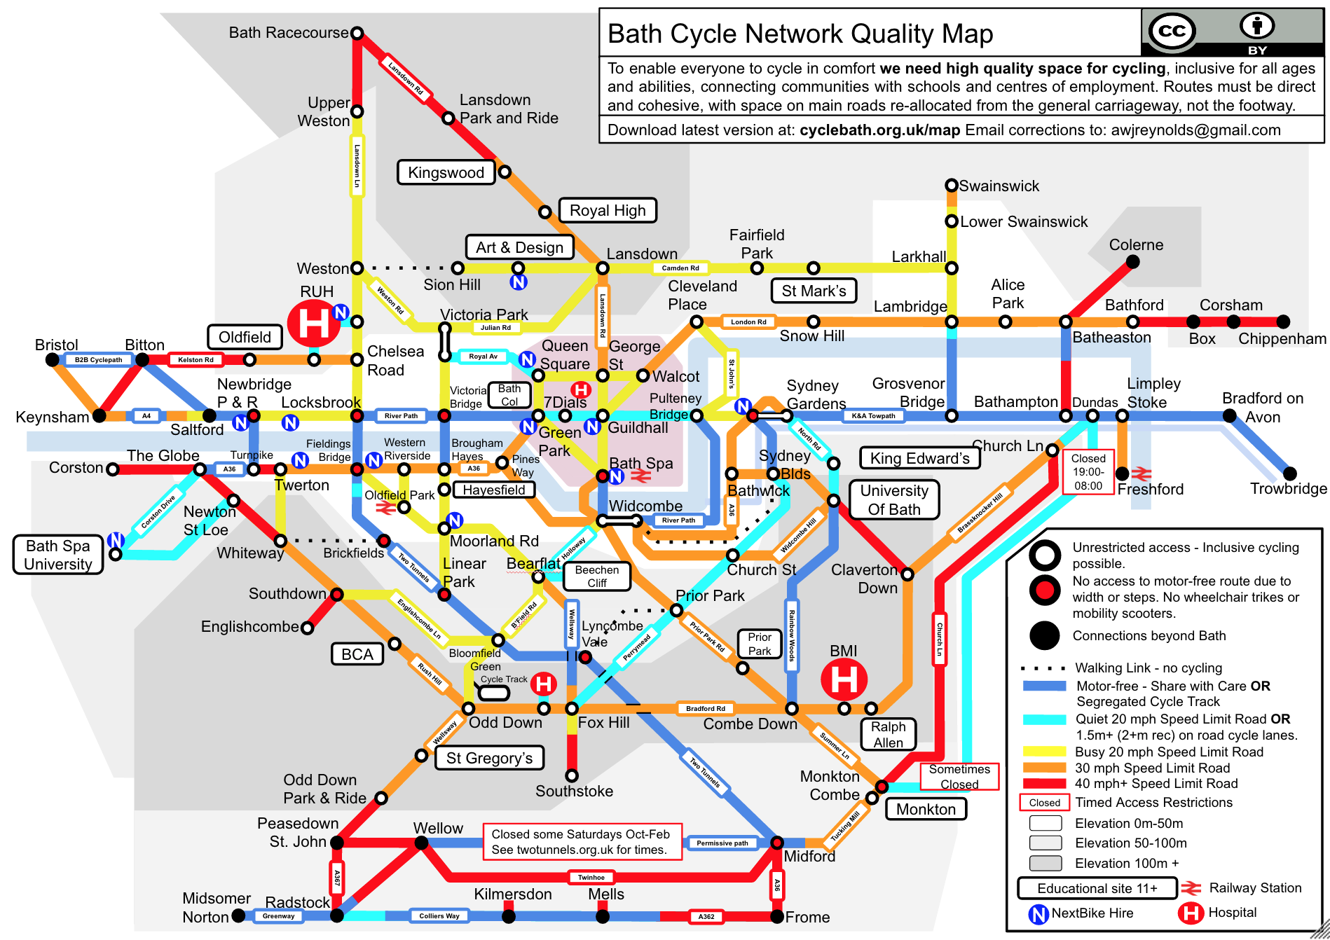
Objectives
Audit of current network providing “ground truth”
Enable a vision of the future
Make public and council aware of problems
Facilitate council strategic planning
Enable Councillors to act
Help people get around

Slide 3
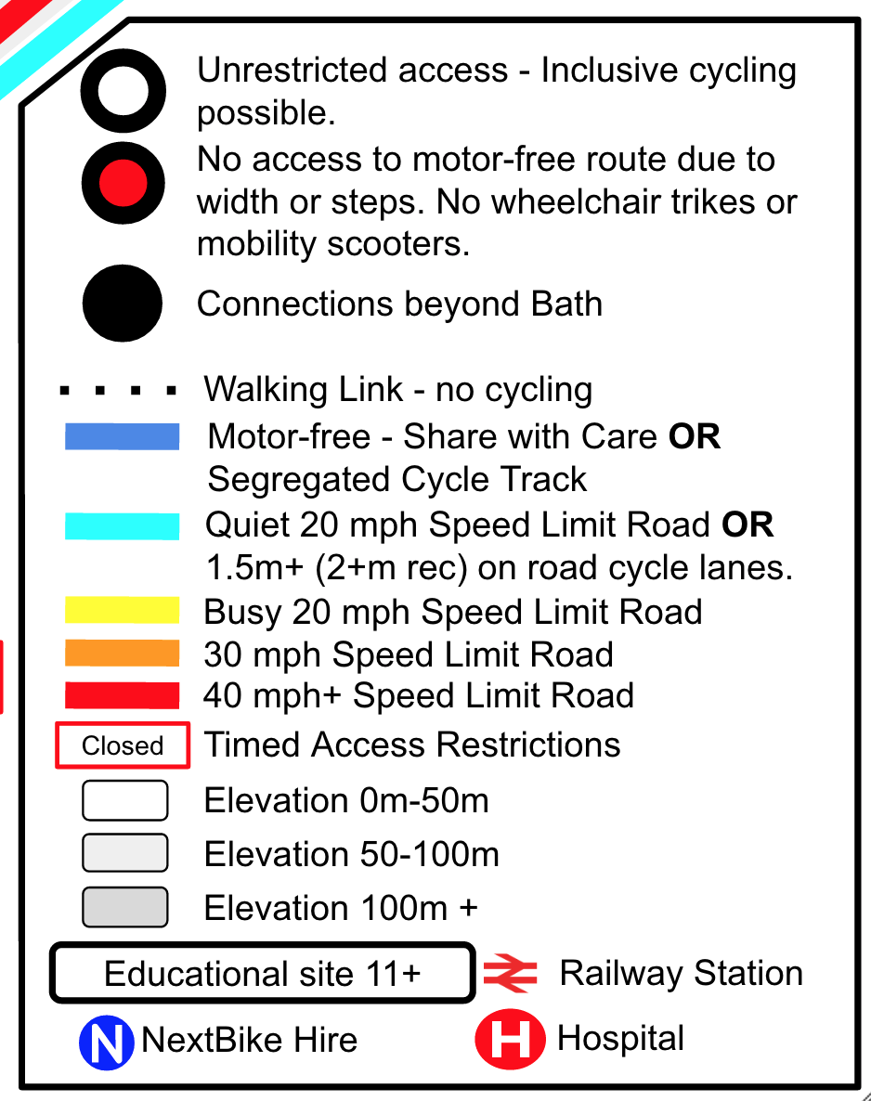
Highlight problems through the Map Legend
Nodes = Inclusive cycling not possible
Nodes = Highlight communities and desire lines
Walking Link = Identify upgrade needed
Route colours + Schools = Safe cycling needed.
Educational Sites 11+ = Kids could be cycling to school from communities if safe routes provided.
Elevation = Create good networks at the same elevation.
Bike Hire = Need for more hire stations linked to bus routes
Highlight Hospitals and Railway Stations
Colour Blind Safe
Simple message “Turn the map blue!”

Slide 4

Share Share Share
Creative Commons BY
Ensures as wide a usage as possible.
Allows councils and other organisations to use as they wish and EDIT as they wish.

Slide 5
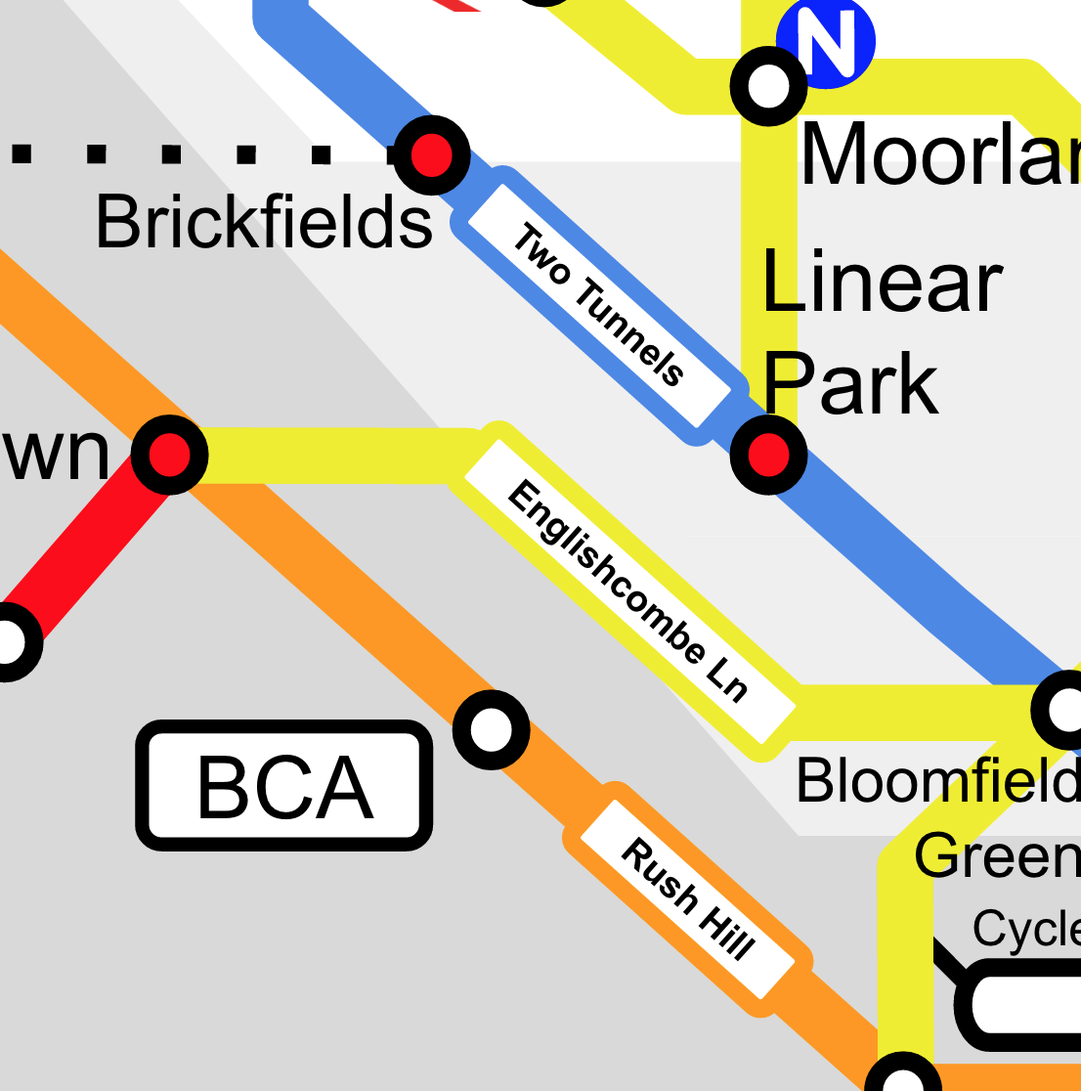
Street/Route Names
Helps people orientate themselves.
Helps people find new routes.
Gives Councillors ownership of a route.

Slide 6
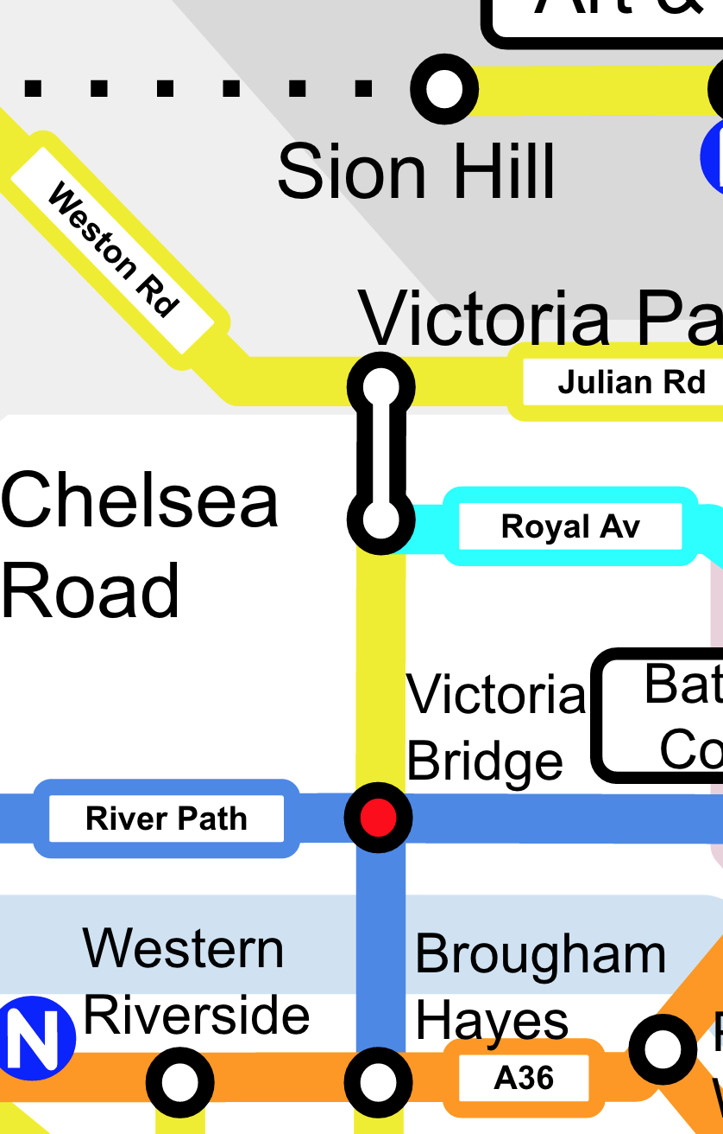
Node or Hub?
Node when simple connection and logical end point.
Hub when too many routes make map complex.
Hub when area is large (e.g. large parks)

Slide 7
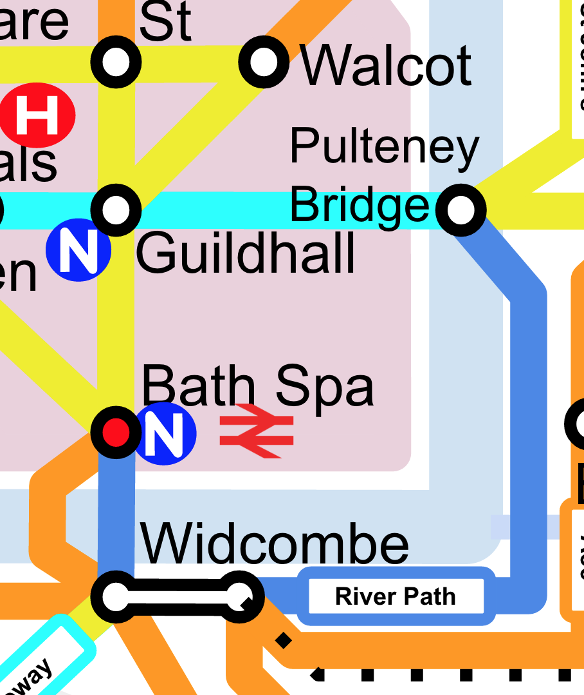
Distance Irrelevant
Do not focus on distance.
Guildhall to Pulteney Bridge 50m
Widcombe to Pulteney Bridge 1200m

Slide 8
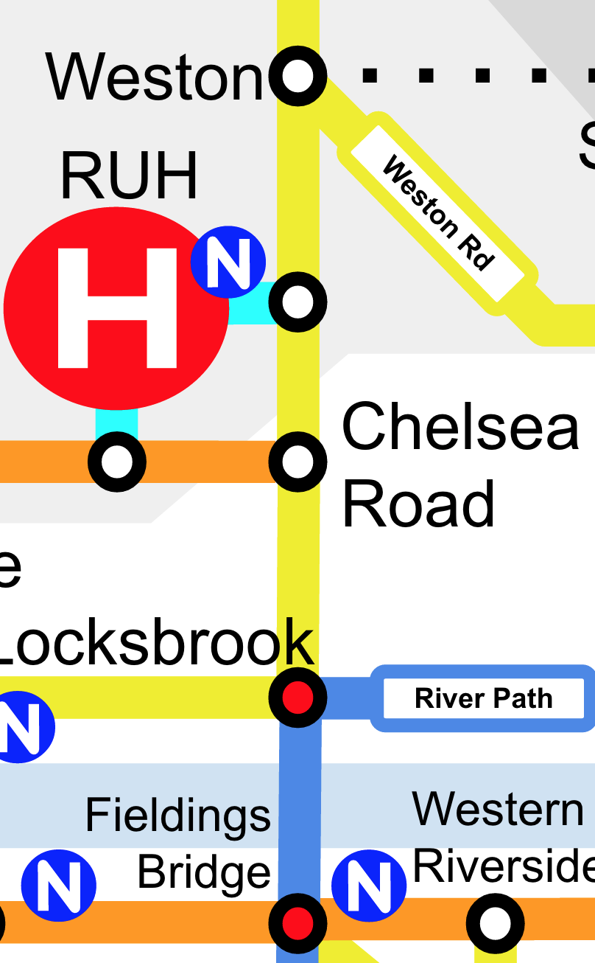
Direction important
Make sure things are on the “right” side of the road.
Nodes/Hubs should be in that “general direction”
Keep angles at 45 degrees.

Slide 9
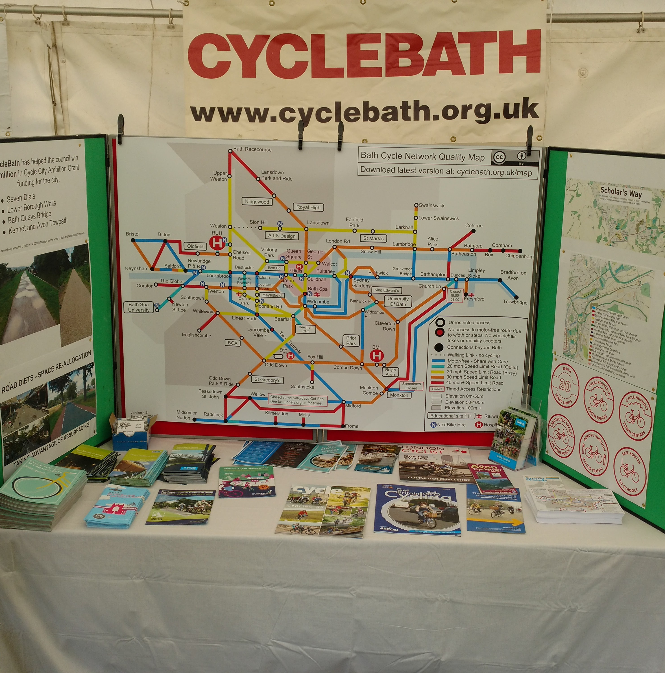
Plan wisely
Google Draw & draw.io allow online collaboration
PDF export is vector pdf and scales to A0!
You will run out of space.
Make page A2 size at least.
Use different size fonts as needed.
Use PNG as it vector scale.

Slide 10
Public Engagement
Share your evolving map with ALL your Councillors
Share and talk with the public
Ask council officers for information
Ask people in your campaign group
Print and distribute around your city

Slide 11
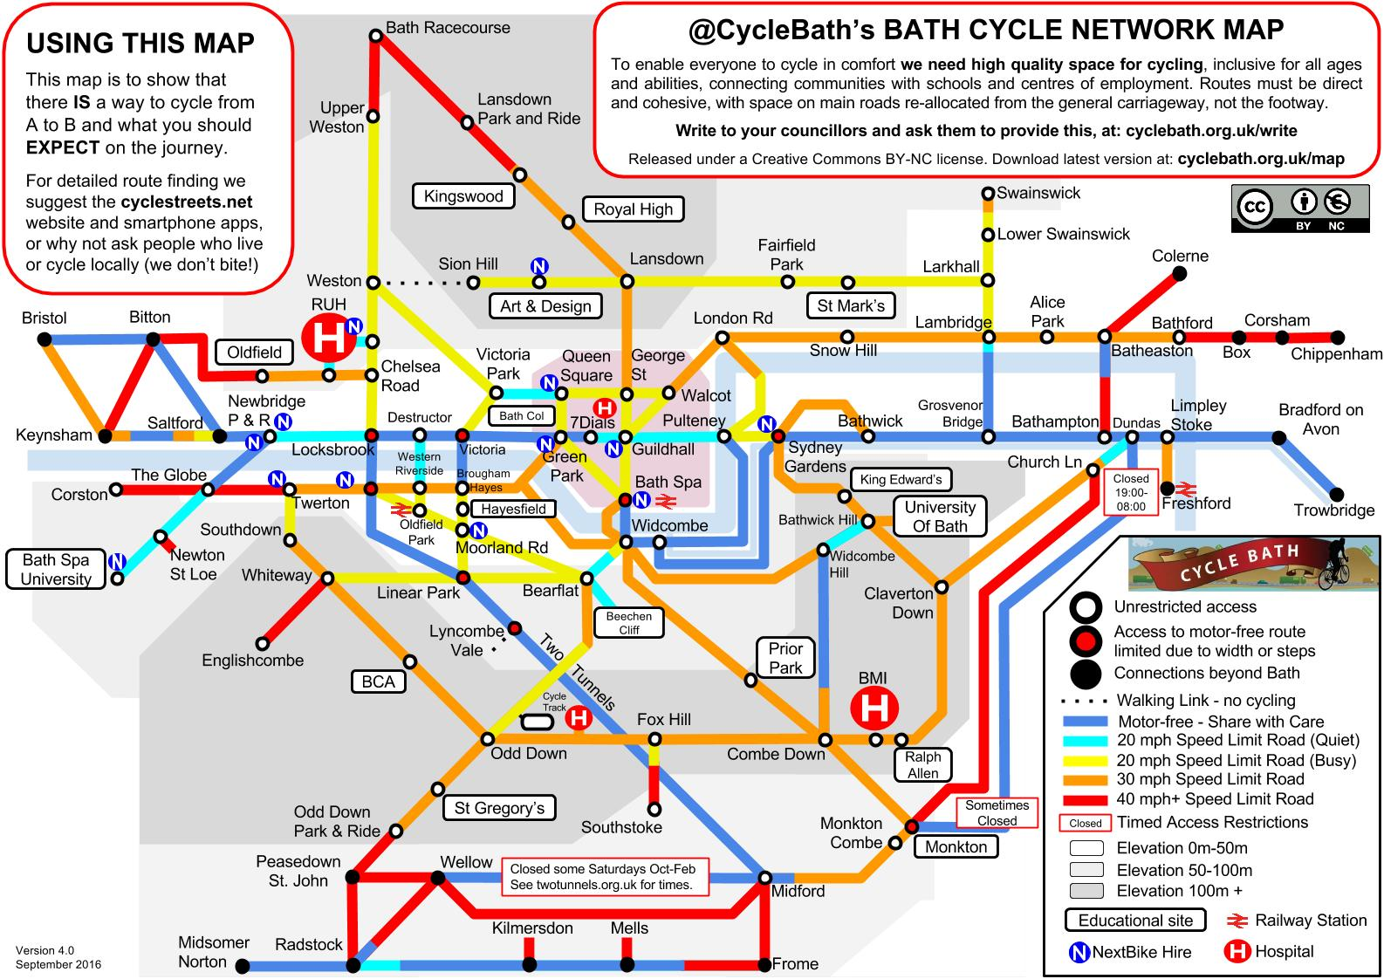
Successes
Council are using it as part of strategy planning and engagement
Working with Canal and River Trust to develop one for their towpath network to enable better strategic planning
Bath (DONE) & North East Somerset (NEXT)
2017 Map print run planned sponsored by Local Bike Shops
Key messages are getting through!
  Inclusive cycling
  Safe routes to schools

Slide 12
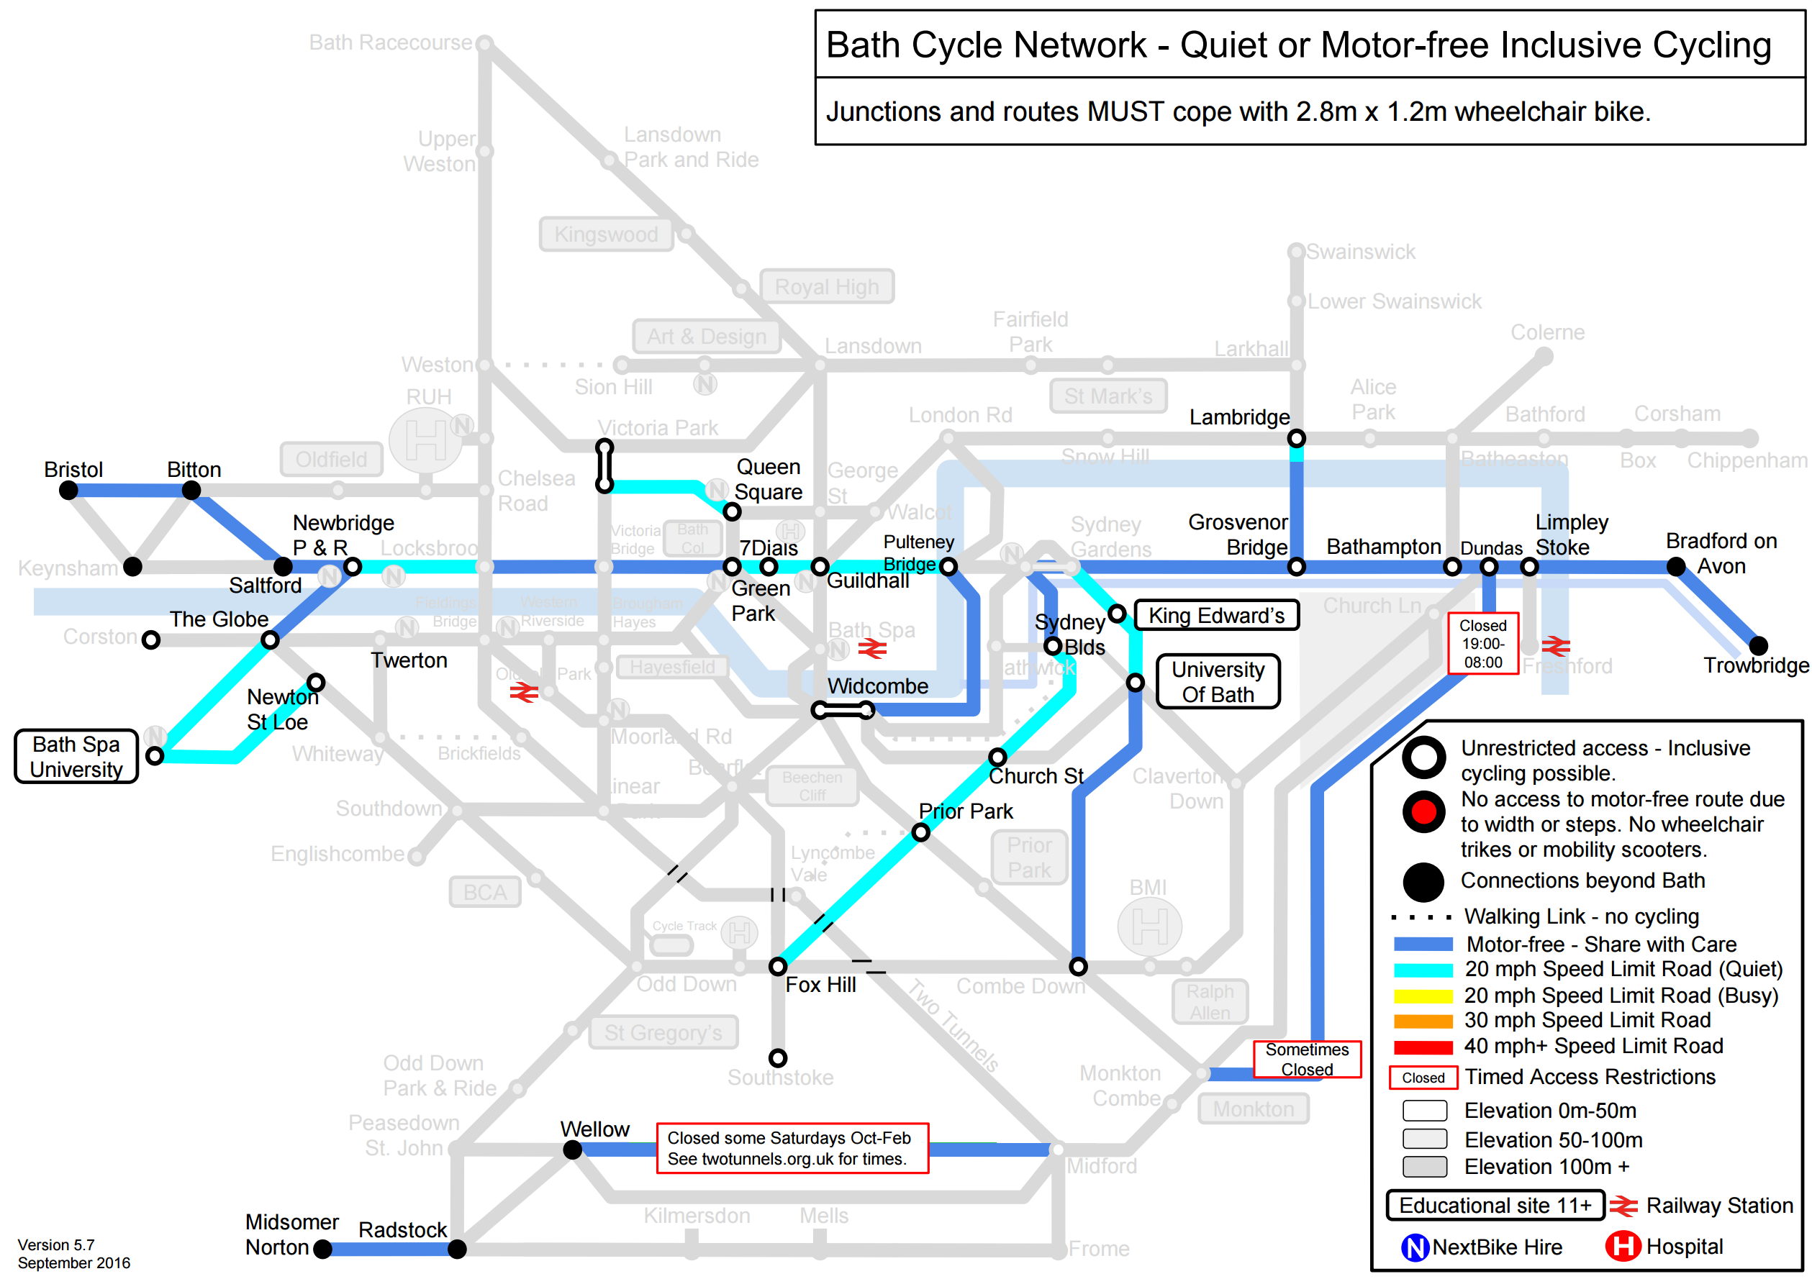
Focusing on a message:
“Inclusive Cycling Possible”

Slide 13
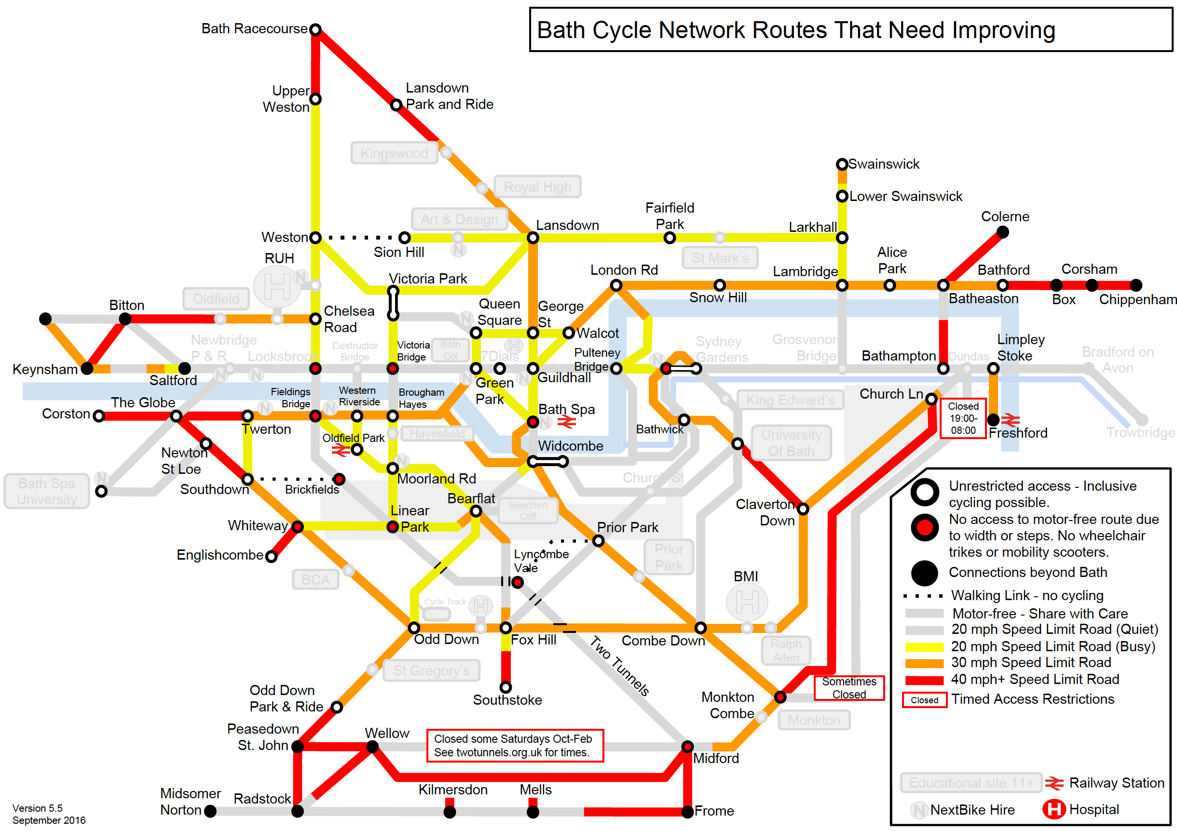
Focusing on a message:
“Councillors you have a LOT of work to do.”

Slide 14


