Slide 1

‘Tube Mapping’
Tom Guha
Space for Cycling Campaigner
tom.guha@cyclinguk.org
#spaceforcycling

Slide 2
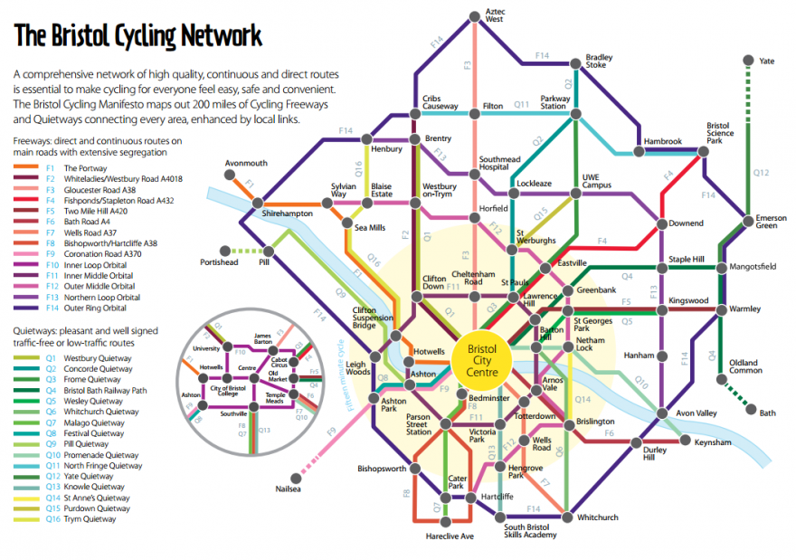
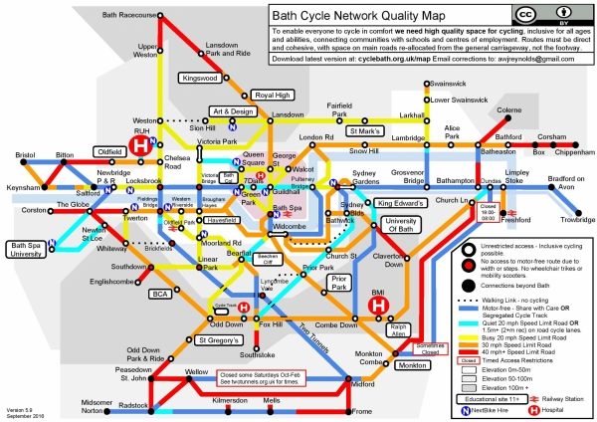
What is a Tube Map?

Slide 3
How?

Slide 4
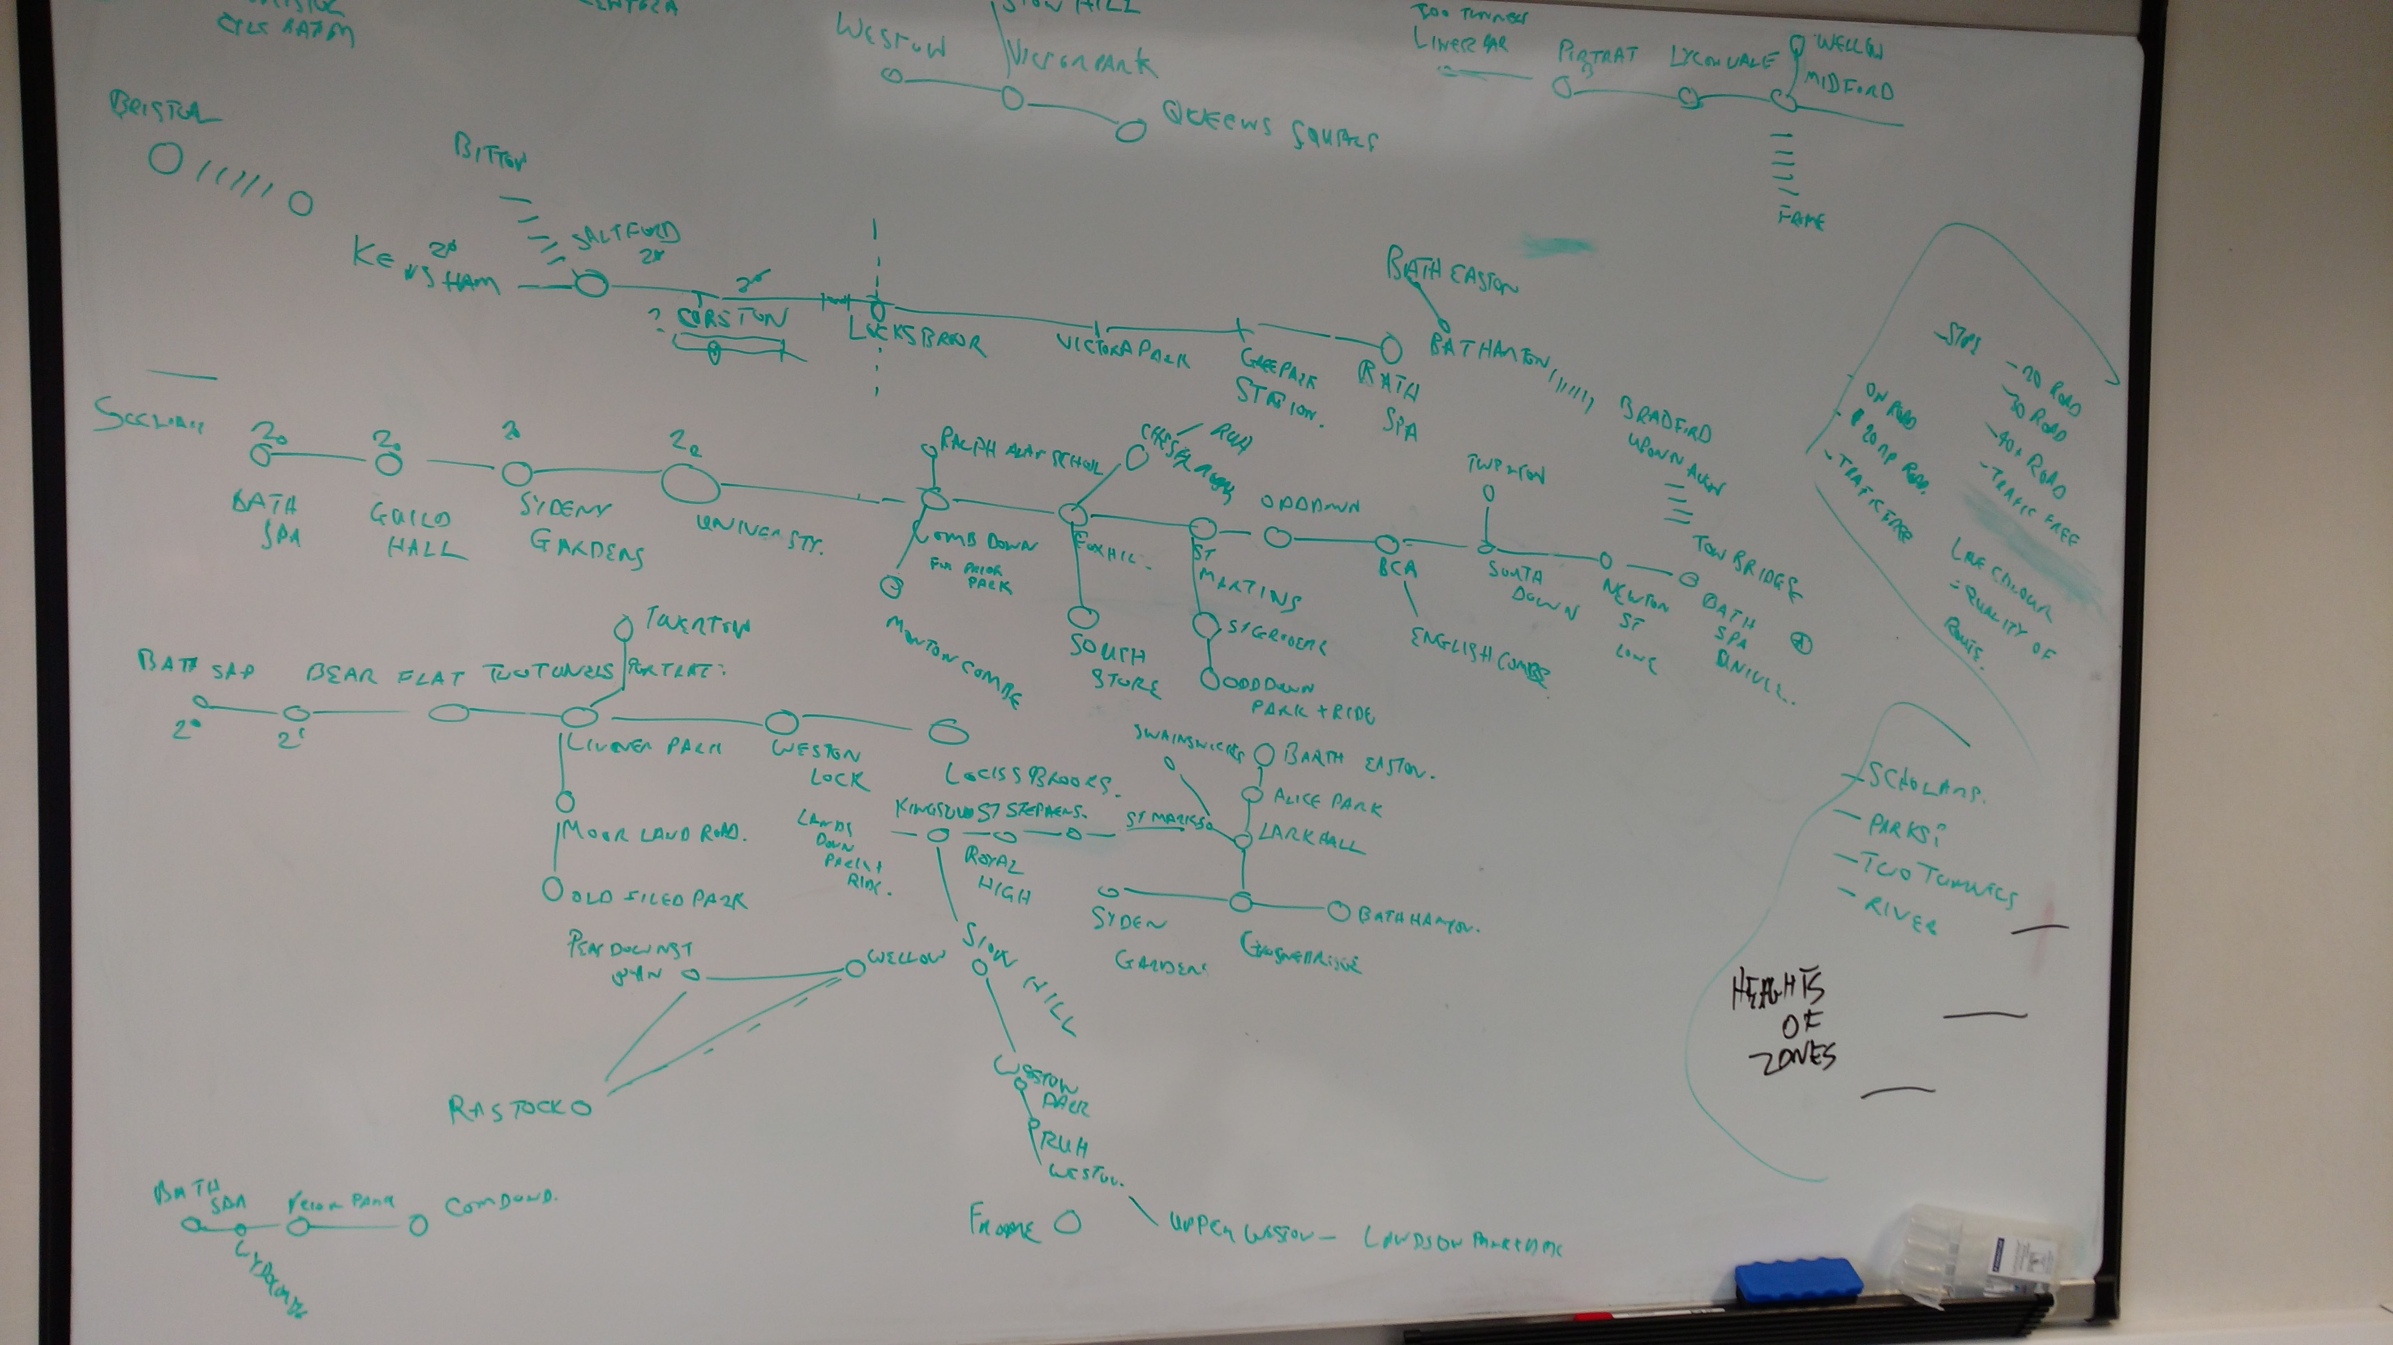
How?

Slide 5
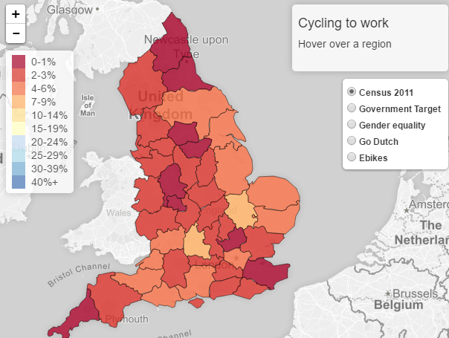
Research
Consultation with members/other local cyclists
www.pct.bike

Slide 6
Cost

Slide 7
Useful Tips
Document your research/production – may make it more compelling to Councillors
Create main arterial routes first
Work strategically – from the centre out
Collaborative
Not one day/one week – evolves over time
Not for navigation – is a useful lobbying tool
Send to all Councillors and local press
Don’t worry too much about how it looks – we can give it a ‘cosmetic makeover’ later on!

Slide 8
Make your own
New template: goo.gl/oHu0xA (‘File’>’Make a copy’)
How to: cyclinguk.org/guide/make-tube-map-cycle-network

Slide 9
Further help
Tom.guha@cyclinguk.org
01483 238 321

