Slide 1
Forming and Running a Local Campaign Group
Bracken Van Ryssen – Chair Solihull Bicycle Campaign

Slide 2
Aims
Provide an overview of how to structure and run campaign activities.
Talk about what worked and what didn’t.
Highlight some useful campaign tools.
Inspire you to achieve more with your campaign group.

Slide 3
Filling a void
?

Slide 4
Setting up a Digital Presence
“Build it and they will come”
Blackfriars Bridge (Mark Treasure: @AsEasyAsRiding)

Slide 6
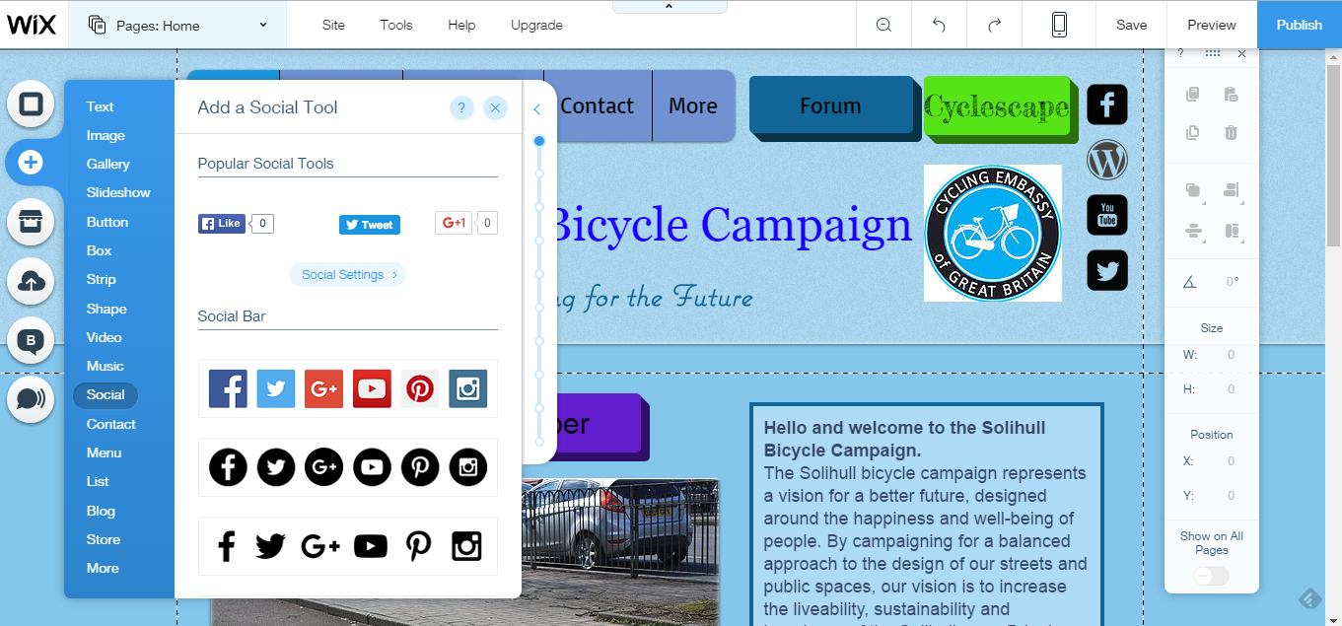

Slide 7
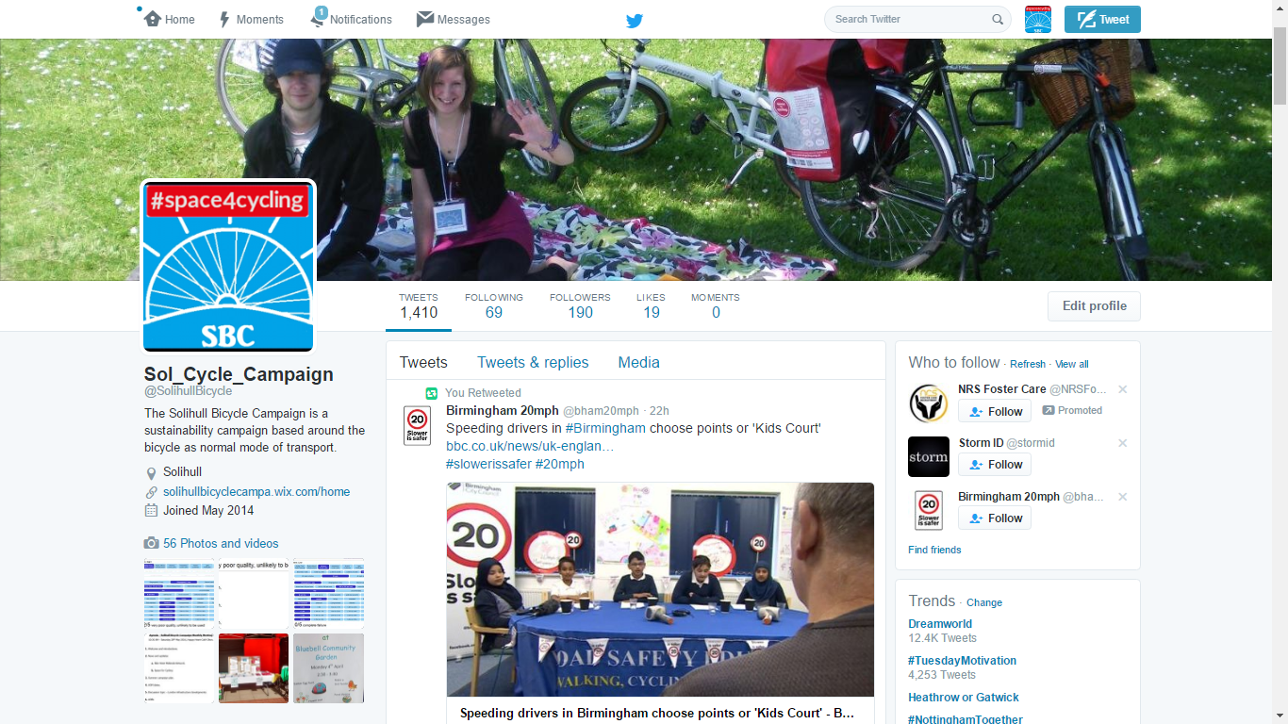

Slide 8
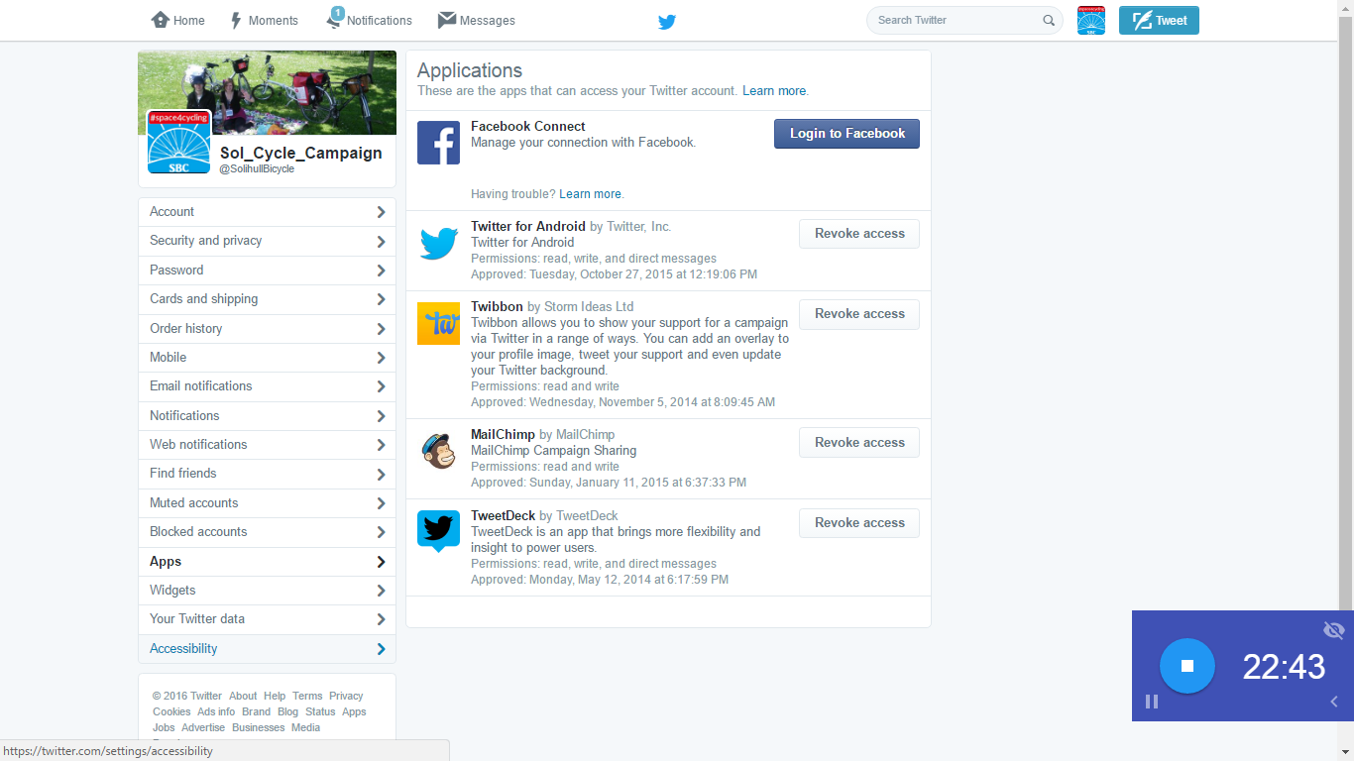

Slide 9
Membership Structures
How to keep track of membership?
How to create value?
How to inform and inspire?

Slide 10
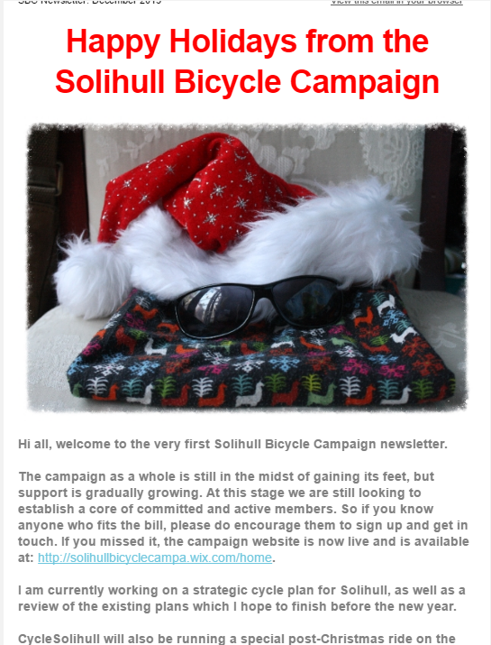
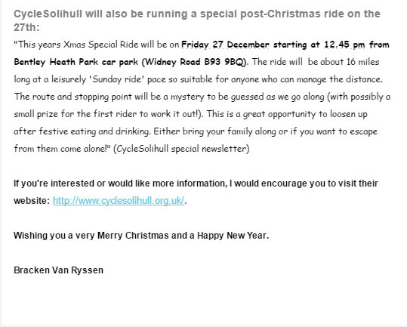

Slide 11
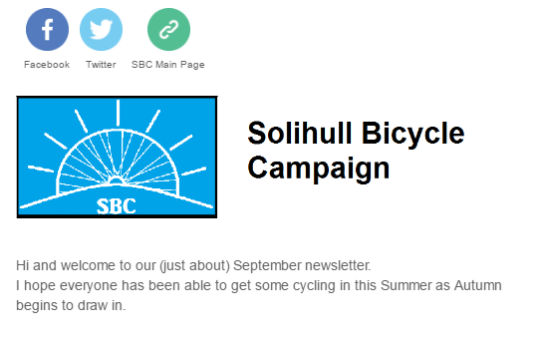
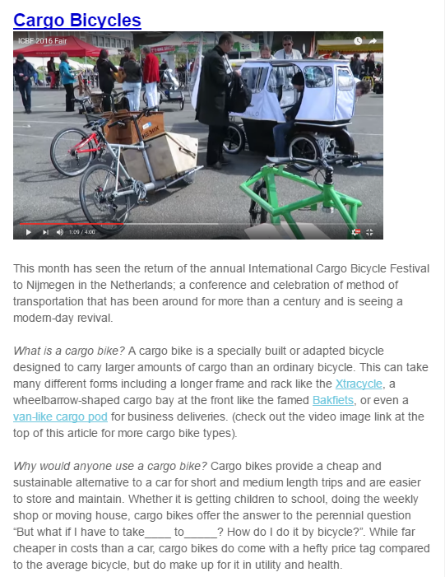
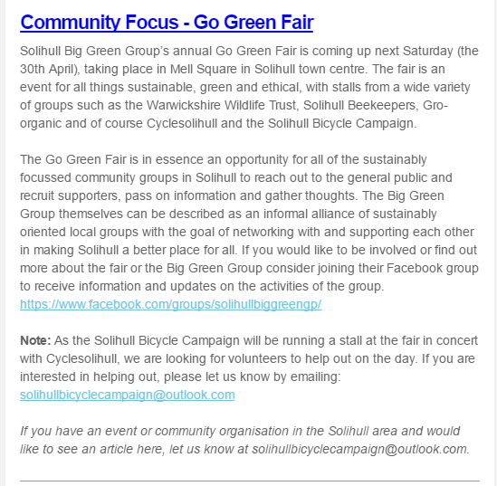
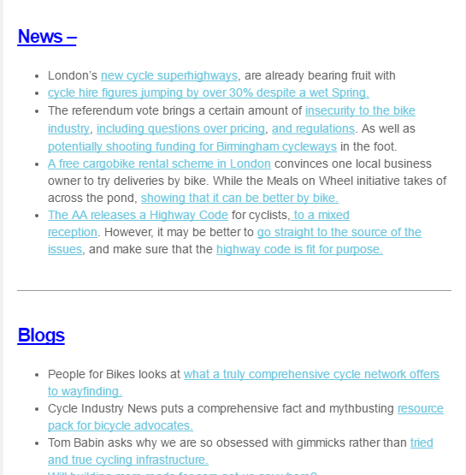

Slide 12
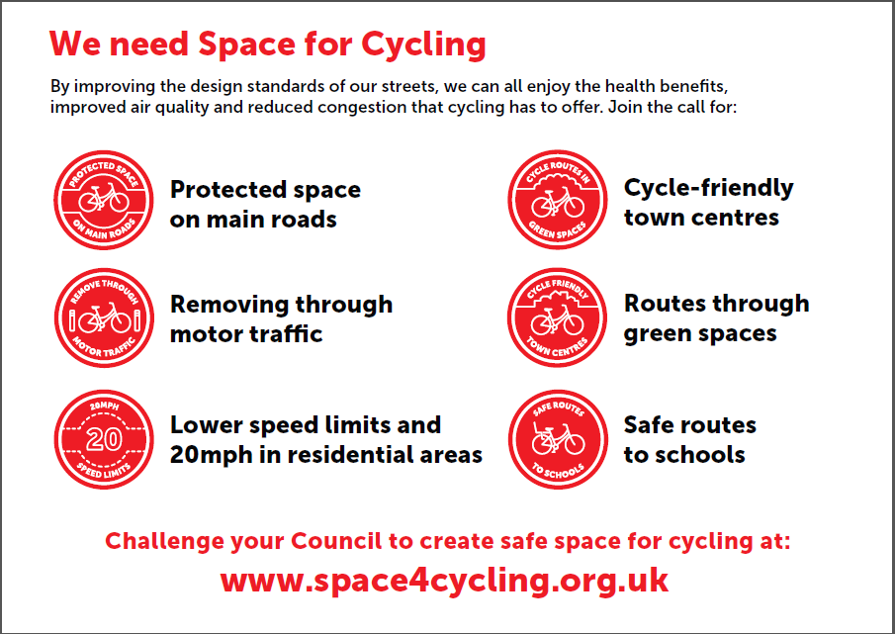
Recruiting Members

Slide 13
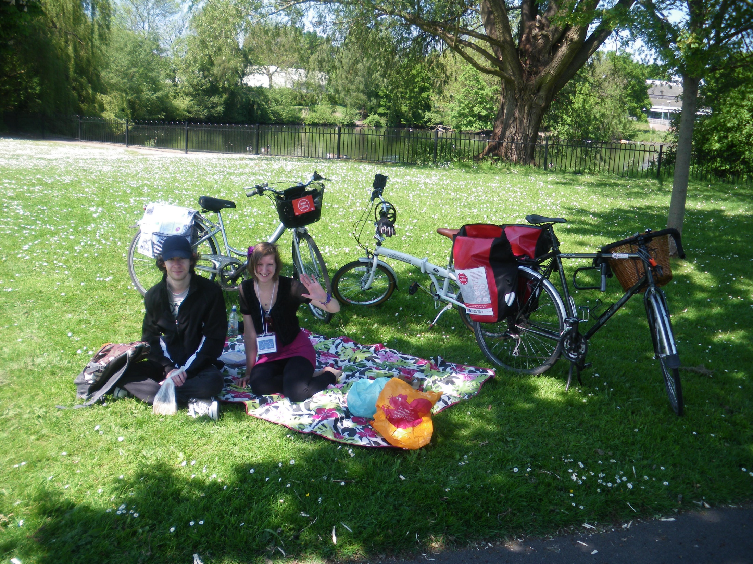
Space for Cycling Ride 2014

Slide 14
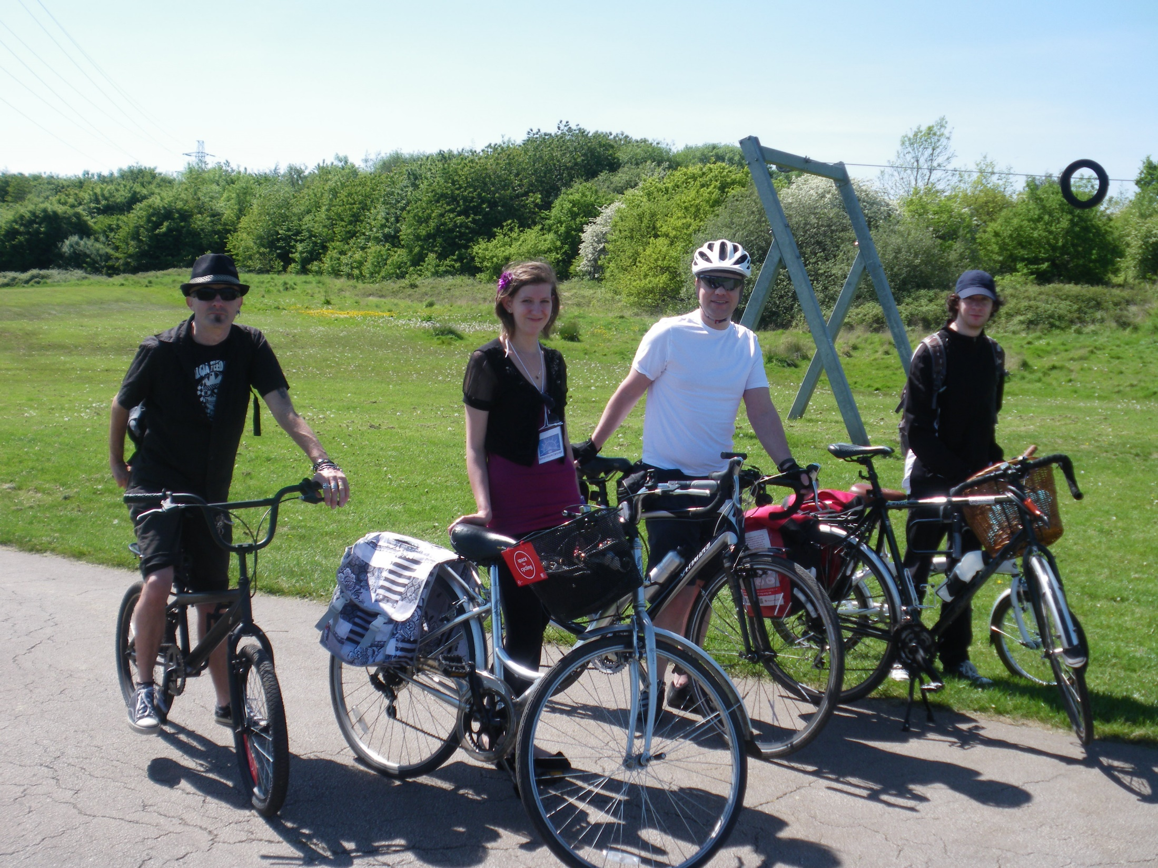
Space for Cycling Ride 2014

Slide 15
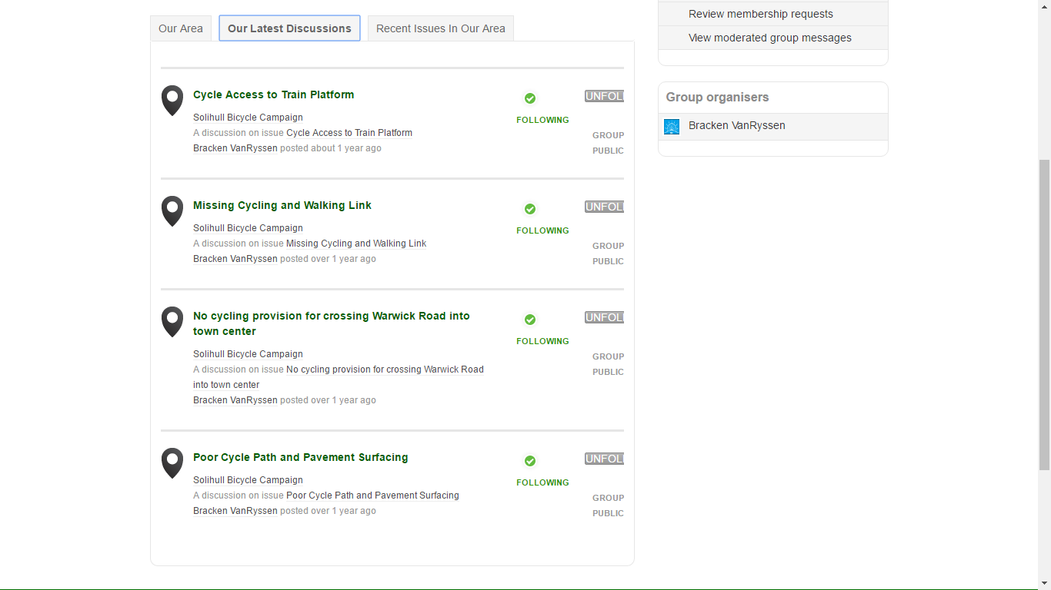
2015 Infrastructure Safari

Slide 16
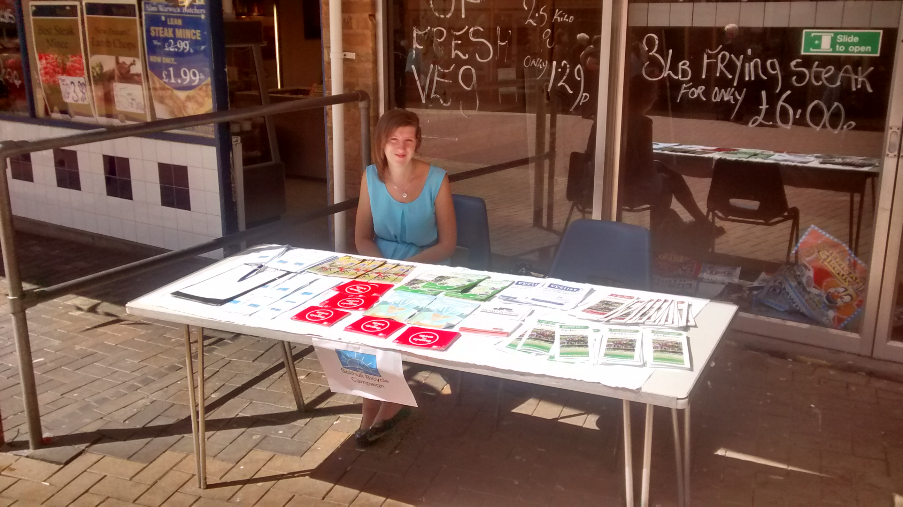
Kingshurst Fair 2015

Slide 17
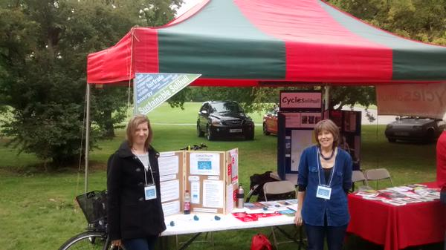
Fun in the Park, 2015

Slide 18
Meetings
Keep the meeting schedule manageable.
Choose dates and times wisely.
Work in informative segments.
Keep it light.

Slide 19
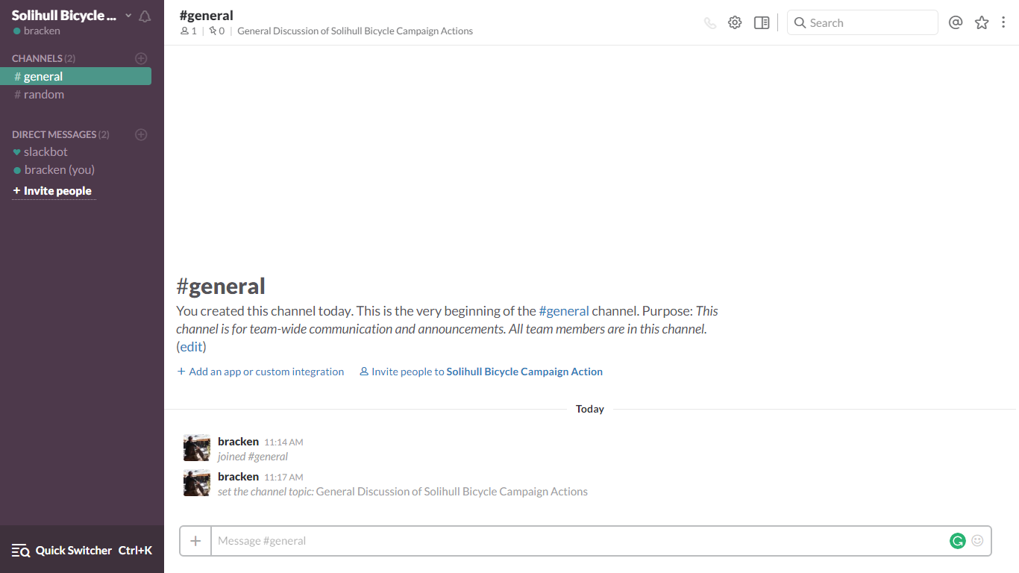
Meeting alternatives

Slide 20
Next steps
Develop our planned cycle network map.
Cultivate councillors as cycle champions.
Continue growing membership.

Slide 21
Top Tips
Don’t wait for permission.
Delegate wherever possible.
Do what you can, when you can.
Develop Key contacts as soon as possible.

